Slide 1
Jewelry Palace

Slide 2
Mg Aung Thura Kyaw(KPTMYK-001253)
Mg Kyaw Soe Win(KPTMYK-001368)
Mg Nanda Tun(KPTMYK-001376)
Ma Kay Thazin Phoo(KPTMYK-001378)
Ma Hsu Moe Yu San(KPTMYK-001352)
Ma May Thet Paing(KPTMYK-001370)
Group-I
Team Members

Slide 3
Content
Chapter1 Introduction
Chapter2 Feasibility Study
Chapter3 Considerations
Chapter4 Design
Chapter5 Conclusion

Slide 4
Objectives
The objectives of Jewelry Palace:
To create a seamless and user-friendly online shopping experience for customers.
To include personalized services, such as custom designs and engraving, to enhance customer satisfaction.
To increase international business or improve business markets by selling online

Slide 5
Chapter1 Introduction
1.1 Overview of the project
Jewelry Palace (JP) project aims to create an innovative platform that connects jewelry designers and artisans with customers seeking unique and high-quality pieces.
This project will feature an online marketplace where users can explore a diverse range of handcrafted and bespoke jewelry items.

Slide 6
Cont’d
1.2 The need for the project
Despite the proliferation of online and jewelry stores, many customers find the lack of product variety.
It faces problems such as inconsistent pricing and inadequate customer service.
The goal is to address these challenges by creating a jewelry selling platform that offers a variety of high-quality, perfectly crafted jewelry pieces.

Slide 7
Cont’d
1.3 Overview of Existing System and Technologies
There are two existing system: Switzerland and Online Car Ticket Selling System. Jewelry Palace Project is a sales project like an online car ticket selling system. But Jewelry Palace is mainly to sell high quality and perfectly designed jewelry.
1.4 Deliverables
JP is a web based on software system that contains a central database and functionalities for various stakeholders.
Since many numbers of users have involved different services will be provided to different users.

Slide 8
Chapter2 Feasibility Study
2.1 Financial Feasibility
A detailed financial plan should include cash flow projections and a break-even analysis to determine how long it will take to recoup the initial investment and achieve profitability.
By carefully examining these points, the viability and long-term success of an online jewelry business can be measured.

Slide 9
Cont’d
2.2 Technical Feasibility
Project JP is a complete web-based application.
The main technologies and tools that are associated with OSSS are HTML, CSS, JS, JSP, MySQL, Diagram tools (MYSQL Workbench).

Slide 10
Cont’d
2.3 Resource Feasibility
Resource that are required for the JP project includes:
Programming device (Laptop)
Hosting space (freely available)
Programming tools (freely available)
Programming individuals
2.4 Risk Feasibility
Risk feasibility can be discussed under several context.

Slide 11
Cont’d
2.4.1 Risk Associated with Size
Estimated size of the product in line of codes: not exceed 200 MB
Estimated size of product in number of programs: exceed 200MB
Size of database created or used by the product :10000 entries per table
Users of the product : Admin and user
Number of projected changes to the requirements for the product? Before delivery? After delivery?
Amount of reused software : Eclipse and MySQL Workbench

Slide 12
Cont’d
2.4.2 Business Impact Risks
Effect of this product on company revenue : customer preferences
Reasonableness of delivery deadlines :4 weeks
Number of customers who will use this product and consistency of their needs relative to the product: 2 main categories
Sophistication of end users : help documents and making GUIs
Amount and quality of product documentation that must be produced and delivered to the customer : a freeware and opens source system
Costs associated with delivery : hosting cost

Slide 13
Cont’d
2.4.3 Customer Related Risks
Inefficient customer support can result in delayed responses to queries or issues, impacting the overall customer experience negatively.
2.4.4 Process Issue Risks
JP will follow the RUP software development process.
This provides the flexibility to accommodate changing software requirements of JP.

Slide 14
Cont’d
2.5 Social/ Legal Feasibility
JP can mitigate risks, build trust with customers, and establish a solid foundation for long-term success in the market.
JSP software libraries that are used in this system are free open-source libraries. Since this system will greatly help the needs of eliminations and statistical distribution.

Slide 15
Chapter3 Considerations
3.1 Performance
Response time: less than 2 seconds
Processing time: less than 2 seconds (no batch processing involved)
Query and reporting times: yet to be tested
Throughput: yet to be tested
Storage: yet to be tested

Slide 16
Cont’d
3.2 Security
Security measures are provided in many aspects in this system.
Users will have to authenticate using the username and passwords.

Slide 17
Cont’d
3.3 Usability and Ease of Use
The user is to provide with a complete user manual as a pdf file.
The interfaces are designed to be easy and familiar to any potential user.
No additional training is required to use the system.
3.4 Capacity and Scalability
Jewelry Palace can handle increasing traffic and scale effectively to meet the demands of users.

Slide 18
Cont’d
3.5 Availability
Jewelry Palace will be available throughout the 24 hours.
3.6 Maintainability
Automated Testing
Code Quality and Standards

Slide 19
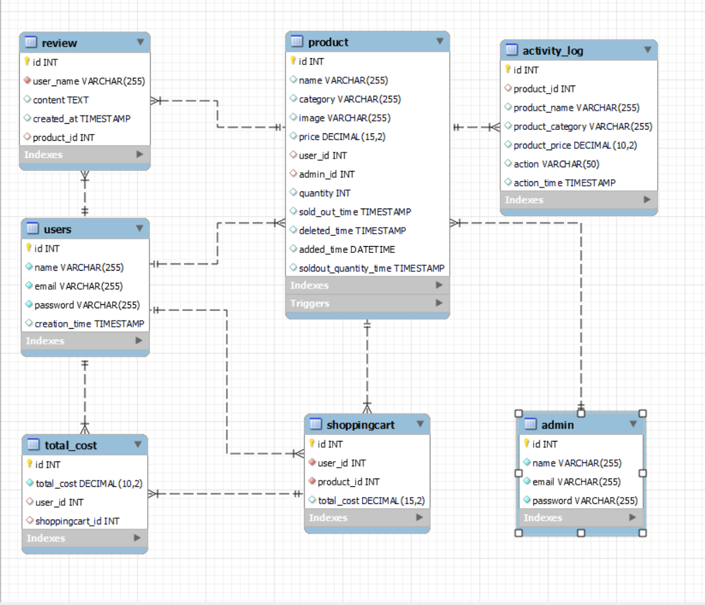
Chapter4 Design
4.1 Entity Relationship Diagram
Entity Relationship Diagram for Jewelry Palace

Slide 20
Chapter5 Conclusion
Due to the above topics, this project JP is feasible in terms of implementation.

Slide 21
References
https://www.google.com/
https://shweshops.com/

Slide 22
THANK YOU

